Slide 1
MA AGO Amendments to ISO-NE
Energy Security Improvements Proposal
NEPOOL Markets Committee
February 13, 2020

Slide 2
INTRODUCTION
The MA AGO is proposing 2 separate amendments to ISO-NE’s ESI proposal at this time.
Each is a stand alone to be voted separately.
Each is intended to improve ESI.

Slide 3
Proposed Amendments
Amendment #1: Eliminate RER from the ESI design.
Amendment #2: Add a look back provision to the ESI program to enable evaluation of its efficacy.

Slide 4
Amendment #1

Slide 5
Amendment # 1:
Remove RER from the ESI Design
Purpose: This amendment eliminates RER.
Method: Strike all language on RER-90 & RER-240.
Amendment may be modified or withdrawn subject to receipt of additional analysis and impact analysis runs.

Slide 6
RER should be removed from the ESI design.
Removing RER saves customers $52-$153 million each year.
  Savings estimate does not include incremental savings associated with avoiding load forecast error or supply uncertainty costs.
RER design is incomplete.
  Load forecast error and supply uncertainty components remain largely, or completely, undefined.
Removing RER does not disrupt other ESI components.
Updates to NPCC Directory 5 do not require an RER-style product.
Link between RER & fuel security is weak.

Slide 7
Removing RER saves $43-153mm/year without affecting system reliability.
Removing RER reduces ESI cost by $52 to 143 million annually.
  $9-73 million reduction in winter; $43-70 million in non-winter. [1]
Removing RER does not increase the number of scarcity hours.
  Lack of scarcity under both ESI and CMR implies RER is not needed to avoid shortage.
Removing RER reduces most operational metrics by <20% [2]. Compared to full ESI, removing RER leads to:
  0-16% decrease in NG consumption when NG supply is tight.
  14% decrease to 7% increase in minimum daily deliverable energy from oil.
  17-43% decrease in average deliverable oil.
Given lack of shortage hours, reductions in operational metrics should be assessed using an economics cost/benefit framework.
  Removing RER does lead to a tighter system, but one which is still reliable.
  Figure Comparing “Central” and “No-RER” Scenarios on next slide.
[1] Analysis Group Presentation (January 28, 2020) at 12-14, 42.
[2] Id. at 16-18.

Slide 8
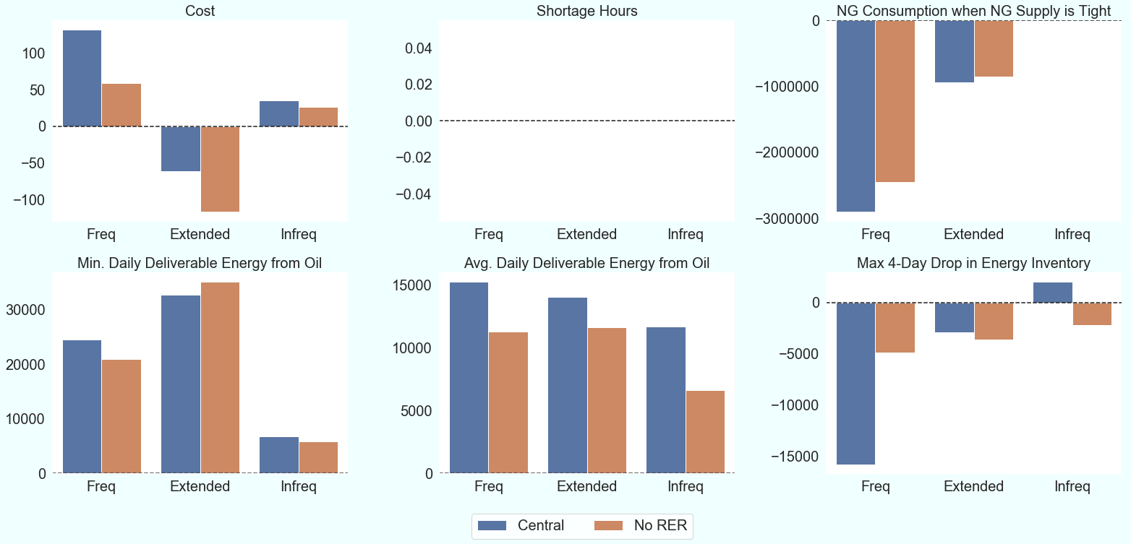
Full ESI vs No-RER Impact Analysis Results (ESI vs CMR, Differences in Differences)
$million/season
hours/season
MMBtu/season
MWh/season
MWh/season
MWh/season
Analysis Group Presentation (January 28, 2020) at 16-18.

Slide 9
RER will likely cost even more than
Impact Analysis estimates.
ISO-NE intends for RER to cover not only reserve restoration, but also “load forecast error” and, perhaps, “supply uncertainty”.
  “Load forecast error” isn’t defined and could be used as blank check for hundreds of MWs extra RER.
    ISO-NE has not provided its opinion on the right amount to procure.
    Most recent “current thinking” suggests that forecast error may require procurement of additional 200 MW/h to 790 MW/h (90% coverage; 99% coverage) for forecast error. [1]
  No estimates for magnitude of possible “supply uncertainty”.
Procurement of RER options for forecast error are not included in main Impact Analysis scenarios, even though this demand is part of the core RER design.
  “RER Plus” scenario in Impact Analysis suggests that increasing RER quantity leads to dramatically higher costs, all else equal.
[1] ISO-NE Presentation (February 11-13, 2020) at 22.

Slide 10
Removing RER does not disrupt other
ESI components.
RER can be removed from ESI design without hindering function of GCR and EIR (this contrasts with claims that EIR and GCR interact and moderate one another).

Slide 11
Recent Updates to NPCC Directory 5 do not require an RER-style product.
NPCC Directory 5 was updated on September 27, 2019, clarifying existing requirements. Some textual changes, but no fundamental shift in requirements or obligations.
  No change to Ten-Minute or Thirty-Minute Reserve restoration requirements.
  No change in possible methods to mitigate a Reserve Deficiency.
New England has maintained reliability since 2012 with existing mitigation approaches.
  Since 2012, NPCC has offered seven methods to mitigate Ten-Minute Reserve deficiencies and five methods to mitigate Thirty-Minute Reserve deficiencies.
As underlying NPCC requirements and restoration methods have remained the same since 2012, it is unclear why RER90 / RER240 are now required for reliability.
  Extra-commitments, a la RER, are permissible, but not obligatory.
  Existing operator actions are sufficient.
Comparison of NPCC language provided in Appendix 1.

Slide 12
Link Between RER & Fuel Security is Weak.
RER has tenuous link to FERC’s fuel security charge in
EL-18-182.
  RER inflates ESI procurement quantities, which may increase fuel inventories. No demonstrated link between increased fuel and improved reliability.
Over past 13 years, RER could have mitigated reserve shortages in just 0.03% of hours (see Appendix 2 for details).
  One long-duration deficiency occurred in cold months (100 minutes, System, 2/12/08).
  Only one long-duration deficiency since 2013 (305 minutes, NEMABOS, 5/19/17)
RER may provide other reliability benefits, but ESI Impact Analysis modeling is unable to capture these benefits.

Slide 13
Amendment #2

Slide 14
Amendment #2
Add a Look-Back
The IMM will report on the performance of the first three years of the ESI program, in its annual report for calendar year 2027.
Report would evaluate the extent to which ESI has achieved operational, market, reliability, energy security and other goals
  Seeks to match program success to goals and objectives contained in FERC’s July 2018 order in EL18-182 and ISO filings in response to the order.

Slide 15
Look-Back Provision, cont’d.
Performance Criteria: In its evaluation, the IMM will use pre-defined performance criteria developed with input from the states, the ISO, and NEPOOL stakeholders.
The IMM will finalize the ESI evaluation criteria and methods and make an informational filing with FERC by June 1, 2026.

Slide 16
Look-Back Provision, cont’d.
The EMM may, but is not required to, respond to the IMM’s report with its own analysis, findings and recommendations. Response subject to informational filing.
In response to any findings and recommendations by the IMM and EMM, ISO-NE will develop program adjustments or explain why it believes they are unnecessary.

Slide 17
Conclusions Amendment # 2
This amendment encourages a timely review of ESI’s performance and a mandate to correct any deficiencies or unanticipated effects after ESI has had a reasonable amount of time to generate performance data.
Collaborative establishment of performance criteria will allow for a thorough, fair and transparent evaluation.

Slide 18
Questions?

Slide 19
Appendix 1
NPCC Directory 5 Language
Comparison of October 11, 2012 and September 27, 2019 Versions

Slide 20
NPCC: Restoration of Ten-Minute Reserve
October 11, 2012 (Section 5.2: Restoration of Ten-Minute Reserve)
  If a Balancing Authority becomes deficient in ten-minute reserve or forecasts a deficiency without counting the contribution of either curtailment of interruptible loads that is not part of normal operations, and/or public appeals:
  5.2.1 It shall restore its ten-minute reserve as soon as possible and within the duration specified by the appropriate NERC standard*
September 19, 2019 (R1: Ten-Minute Reserve Requirements)
  If a Balancing Authority becomes deficient in ten-minute reserve or forecasts a deficiency, it shall restore its ten-minute reserve as soon as possible and within the duration specified in the appropriate NERC standard*.
*NERC BAL-002-2 provides 90 minutes as the Contingency Reserve Restoration Period.
Note: actions to mitigate Ten-Minute Reserve shortages are the same in both versions of Directory 5 (Cf. Appendix B, Section 3.1 (Sep 19, 2019) and Appendix 3, Section 3.1 (October 11, 2012)).

Slide 21
NPCC: Restoration of Thirty-Minute Reserve
October 11, 2012 (Section 5.4: Restoration of Thirty-Minute Reserve)
  If a Balancing Authority is deficient in thirty-minute reserve for four hours, or if it forecasts a deficiency of any duration beyond a four hour horizon, refer to Appendix 3, Sections 3.6 and 3.7 for guidance on the restoration of thirty-minute reserve.
September 19, 2019 (R2: Thirty-Minute Reserve Requirements)
  A Balancing Authority deficient in thirty-minute reserve for four hours, or forecasting a deficiency of any duration beyond a four hour horizon, shall eliminate the deficiency if possible, or minimize the magnitude and duration of the deficiency.
Note: actions to mitigate Thirty-Minute Reserve shortages are the same in both versions of Directory 5 (Cf. Appendix B, Section 4.1 (Sep 19, 2019) and Appendix 3, Section 3.6 (October 11, 2012)).

Slide 22
NPCC: Actions to Mitigate Reserve Shortages
Mitigation Strategies outlined in 2012 and in 2019 are virtually identical. 2019 update to Directory 5 clarifies that:
  Energy Purchases between BAs are optional.
  Firm load may not be counted towards Reserve requirements
NPCC Directory 5 Appendix B Section 3 (Sept 2019) offers seven methods to mitigate Ten-Minute Reserve Deficiencies including:
  Commit sufficient off-line supply-side resources to create additional ten-minute reserve within the restoration period.
  Recall exports, recall planned generator outages
  Count interruptible customer load, count voltage reduction
  Consider the use of Public Appeals.
NPCC Directory 5 Appendix B Section 4 (Sept 2019) offers five methods to mitigate Thirty-Minute Reserve Deficiencies including:
  Obtain additional resources from outside the Balancing Authority
  Recall planned generator outages, recall exports
  Count interruptible customer load, count voltage reduction

Slide 23
Appendix 2
Frequency of Long-Duration Reserve Shortages

Slide 24
Methodology to identify periods where RER would have been useful
ISO-NE reports periods of system or zonal reserve shortage back to October 2006 [1].
  We identify instances where 10-Minute Reserves were deficient for more than 90 minutes.
    RER90 could help with these shortages
  We identify instances where 30-Minute Reserves were deficient for more than 240 minutes.
    RER240 could help with these shortages
  Results on next slide
[1] https://www.iso-ne.com/static-assets/documents/2017/01/rcpf_activation_data_2006_10_thru_present.zip

Slide 25
RER useful <0.03% of time
The number of days since October 2006 is 4880.
Table indicates 1950 minutes of 30-min shortage (1.35 days) and 100 minutes of 10-min reserve shortage (0.07 days).
RER almost never needed
  RER90 would have been useful 0.001% of the time
  RER240 would have been useful 0.03% of the time.
Table: List of Long-Duration Reserve Deficiencies
 |  |  | 10 Minute Reserves |  | 30 Minute Reserves
Start Time | Loc | Duration (Mins) | Avg Def. (MW) | Max Def. (MW) | Avg Def. (MW) | Max Def. (MW) | Type
5/9/07 11:10 | CT | 365 |  |  | 64 | 135 | 30 Min
9/8/07 12:30 | NEMABSTN | 255 |  |  | 107 | 208 | 30 Min
9/8/07 11:05 | SWCT | 250 |  |  | 85 | 156 | 30 Min
9/8/07 15:25 | SWCT | 225 |  |  | 132 | 265 | 30 Min
2/12/08 1:10 | System | 100 | 75 | 203 |  |  | 10 Min
7/22/11 11:50 | System | 265 |  |  | 536 | 670 | 30 Min
7/19/13 11:45 | System | 285 |  |  | 1233 | 3427 | 30 Min
5/19/17 12:45 PM | NEMABSTN | 305 |  |  | 87.1 | 164.8 | 30 Min

